Slide 1
Functions
and Graphs
Twitter: @Owen134866
www.mathsfreeresourcelibrary.com

Slide 2
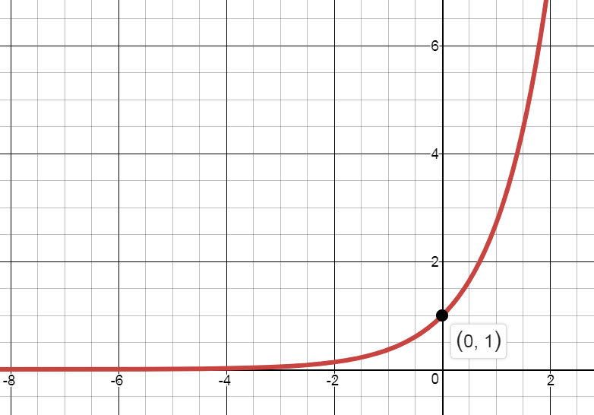
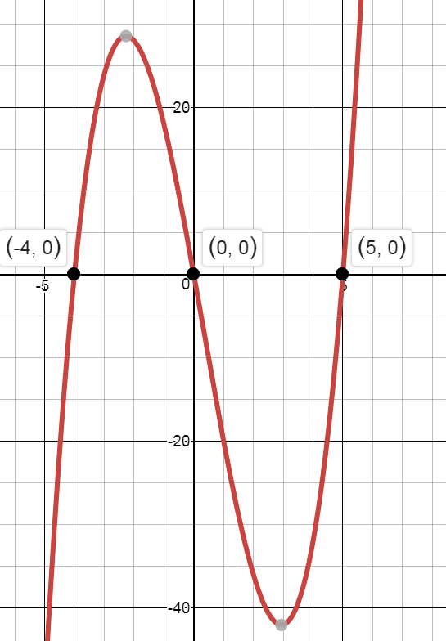
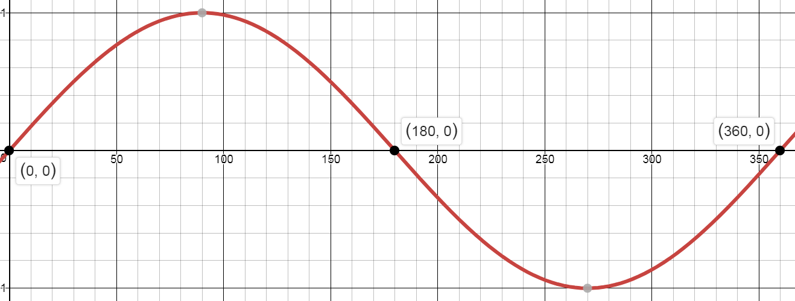


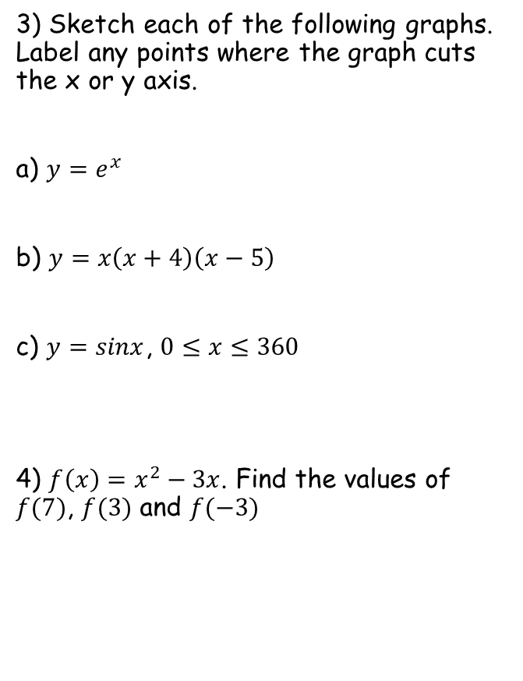

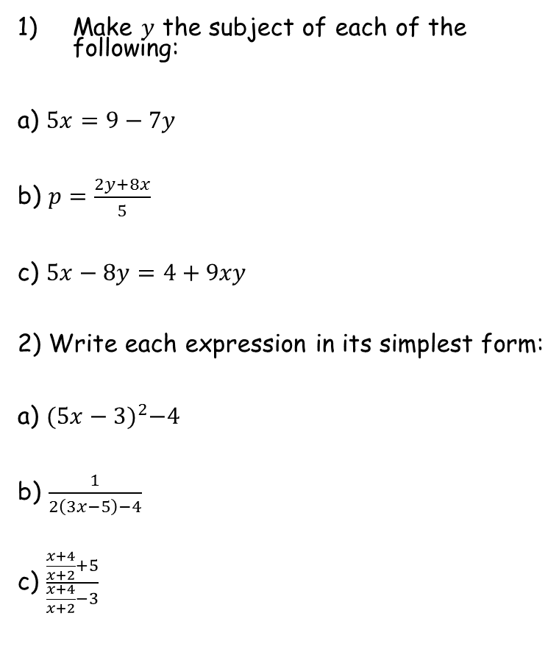




Prior Knowledge Check
Make $y$ the subject of each of the following:
a) $5x=9−7y$
b) $p=\frac{2y+8x}{5}$
c) $5x−8y=4+9xy$
2) Write each expression in its simplest form:
a) ${(5x−3)}^{2}−4$
b) $\frac{1}{2\left(3x−5\right)−4}$
c) $\frac{\frac{x+4}{x+2}+5}{\frac{x+4}{x+2}−3}$
3) Sketch each of the following graphs. Label any points where the graph cuts the x or y axis.
a) $y=e^{x}$
b) $y=x\left(x+4\right)\left(x−5\right)$
c) $y=sinx$, $0≤x≤360$
4) $f\left(x\right)=x^{2}−3x$. Find the values of $f(7)$, $f(3)$ and $f(−3)$
$$y=\frac{9−5x}{7}$$
$$y=\frac{5p−8x}{2}$$
$$y=\frac{5x−4}{8+9x}$$
$${25x}^{2}−30x+5$$
$$\frac{1}{6x−14}$$
$$28, 0, 18$$
$$\frac{3x+7}{−x−2}$$

Slide 3
Teachings for
Section 2A

Slide 4





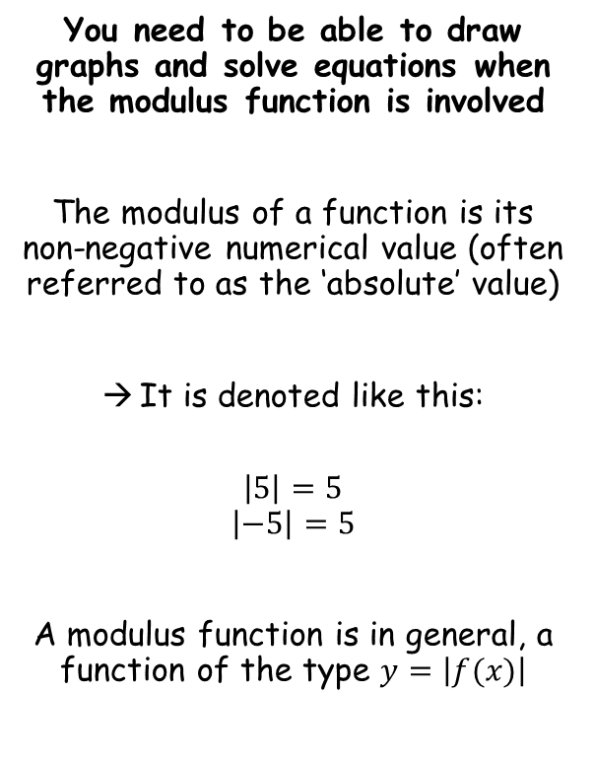








Functions and Graphs
You need to be able to draw graphs and solve equations when the modulus function is involved
The modulus of a function is its non-negative numerical value (often referred to as the ‘absolute’ value)
It is denoted like this:
$$\left|5\right|=5$$
$$\left|−5\right|=5$$
A modulus function is in general, a function of the type $y=\left|f(x)\right|$
$$f(x)=\left|2x−3\right|+1$$
Sub in $x=5$
Find $f(5)$
$$f(5)=\left|2(5)−3\right|+1$$
Calculate the part inside the modulus
$$f(5)=\left|7\right|+1$$
Calculate
$$f(5)=8$$
Lets see what happens when the modulus part is negative…
$$f(x)=\left|2x−3\right|+1$$
Sub in $x=−1$
Find $f(−1)$
$$f(−1)=\left|2(−1)−3\right|+1$$
Calculate the part inside the modulus
$$f(−1)=\left|−5\right|+1$$
The modulus part will become positive
$$f\left(−1\right)=5+1$$
Calculate
$$f\left(−1\right)=6$$
2A

Slide 5


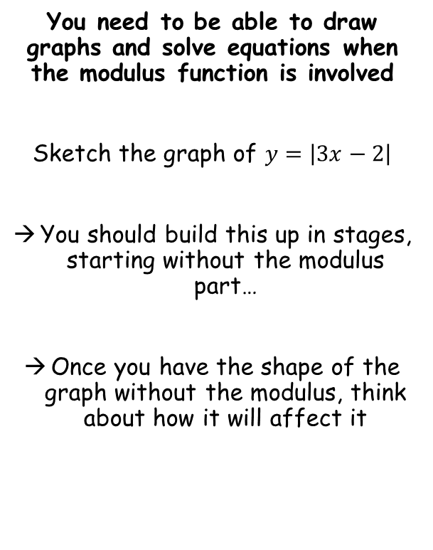




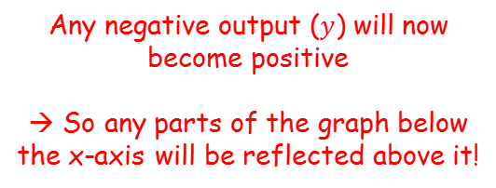
Functions and Graphs
$$y$$
$$y=3x−2$$
You need to be able to draw graphs and solve equations when the modulus function is involved
Sketch the graph of $y=\left|3x−2\right|$
You should build this up in stages, starting without the modulus part…
Once you have the shape of the graph without the modulus, think about how it will affect it
$$y=\left|3x−2 \right|$$
$$2$$
$$x$$
$$\frac{2}{3}$$
$$−2$$
Any negative output ($y$) will now become positive
→ So any parts of the graph below the x-axis will be reflected above it!
2A

Slide 6






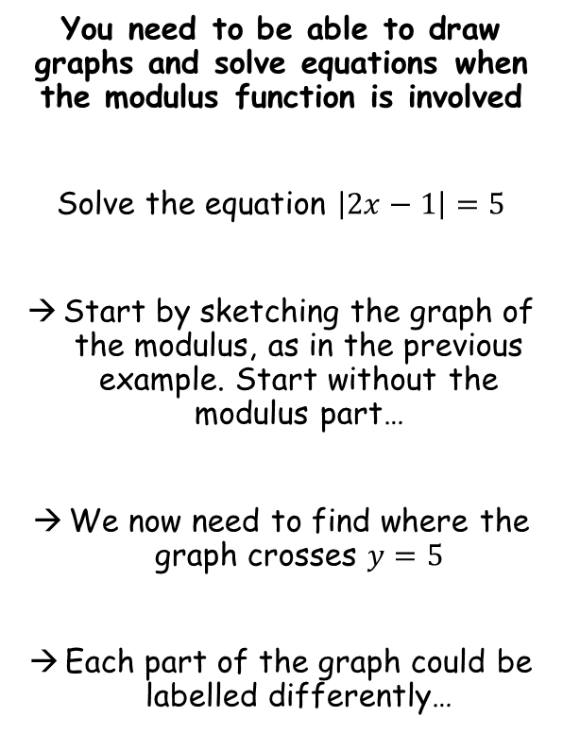










Functions and Graphs
$$y$$
$$y=\left|2x−1 \right|$$
$$y=2x−1$$
You need to be able to draw graphs and solve equations when the modulus function is involved
Solve the equation $\left|2x−1\right|=5$
Start by sketching the graph of the modulus, as in the previous example. Start without the modulus part…
We now need to find where the graph crosses $y=5$
Each part of the graph could be labelled differently…
$$y=5$$
$$y=−(2x−1)$$
$$y=2x−1$$
$$1$$
$$x$$
$$\frac{1}{2}$$
$$−1$$
$$2x−1=5$$
Add 1
$$−(2x−1)=5$$
Multiply by -1
$$2x=6$$
Divide by 2
$$2x−1=−5$$
Add 1
$$x=3$$
$$2x=−4$$
Divide by 2
$$x=−2$$
2A

Slide 7



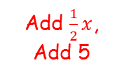


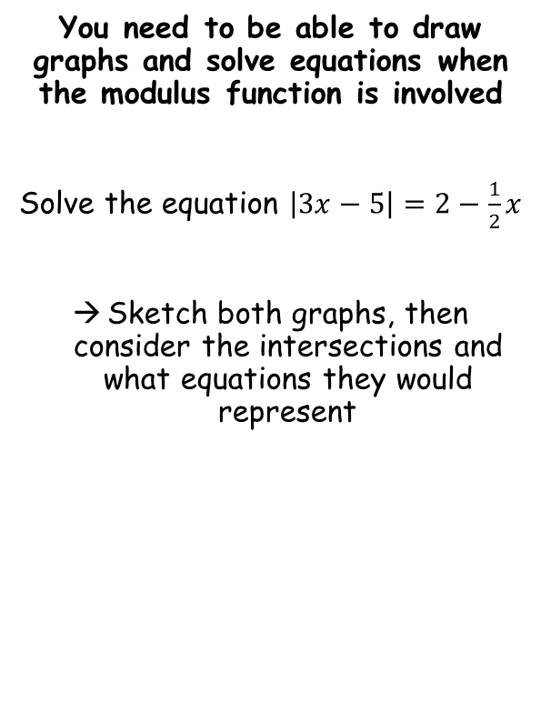














Functions and Graphs
$$y$$
$$y=−(3x−5)$$
$$y=\left|3x−5 \right|$$
$$y=2−\frac{1}{2}x$$
$$y=3x−5$$
You need to be able to draw graphs and solve equations when the modulus function is involved
Solve the equation $\left|3x−5\right|=2−\frac{1}{2}x$
Sketch both graphs, then consider the intersections and what equations they would represent
$$y=3x−5$$
$$5$$
$$2$$
$$4$$
$$x$$
$$\frac{5}{3}$$
$$−5$$
$$2−\frac{1}{2}x=−(3x−5)$$
$$2−\frac{1}{2}x=3x−5$$
Expand bracket
Add $\frac{1}{2}x$, Add 5
$$2−\frac{1}{2}x=−3x+5$$
$$7=\frac{7}{2}x$$
Add 3x, subtract 2
$$\frac{5}{2}x=3$$
Divide by $\frac{7}{2}$
Divide by $\frac{5}{2}$
$$2=x$$
$$x=\frac{6}{5}$$
2A

Slide 8















Functions and Graphs
$$y$$
$$y=3x$$
$$y=−(5x−1)$$
$$y=\left|5x−1 \right|$$
$$y=5x−1$$
You need to be able to draw graphs and solve equations when the modulus function is involved
Solve the inequality $\left|5x−1\right|>3x$
Start by finding where they cross
$$1$$
$$y=5x−1$$
$$x$$
$$\frac{1}{5}$$
$$−1$$
$$−(5x−1)=3x$$
Expand bracket
$$5x−1=3x$$
Subtract 5x
$$−5x+1=3x$$
$$−1=−2x$$
Add 5x
Divide by -2
$$1=8x$$
$$\frac{1}{2}=x$$
Divide by 8
$$\frac{1}{8}=x$$
Consider the values of x for which $y=\left|5x−1\right|$ is above $y=3x$
$x>\frac{1}{2}$ and $x<\frac{1}{8}$
2A

Slide 9
Teachings for
Section 2B

Slide 10
Functions and Graphs
Add 3 onto the set {-3, 1, 4, 6, x)
Mapping Diagrams
A mapping diagram transforms one set of numbers into a different set of numbers. It can be described in words or using algebra. They can also be represented by a Cartesian graph.
The original numbers (Set A, or ‘x’) are known as the domain.
The results (Set B, or ‘y’) are known as the range (ie range of answers)
Set A
Set B
-3
0
1
4
4
7
6
9
x
x + 3
y
y = x + 3
8
6
4
2
x
-2
2
4
6
2B

Slide 11
Functions and Graphs
Square the set {-1, 1, -2, 2, x)
Mapping Diagrams
A mapping diagram transforms one set of numbers into a different set of numbers. It can be described in words or using algebra. They can also be represented by a Cartesian graph.
The original numbers (Set A, or ‘x’) are known as the domain.
The results (Set B, or ‘y’) are known as the range (ie range of answers)
Set A
Set B
-1
1
1
-2
4
2
x
x2
y
y = x2
8
6
4
2
x
-2
2
4
6
2B

Slide 12
Functions and Graphs
One-to-one Function
Functions
A function is a mapping whereby every element in the domain is mapped to only 1 element in the range.
ie) Whatever number you start with, there is only 1 possible answer to the operation performed on it.
An example of a mapping which is not a function would be square rooting, where the starting number may result in no answer, or 2 answers.
Set A
Set B
eg) f(x) = x + 5
eg) f(x) = 3x - 2
Many-to-one Function
Set A
Set B
eg) f(x) = x2 + 1
eg) f(x) = 6 - 3x2
Not a function
Set A
Set B
eg) f(x) = √x
eg) f(x) = 1/_{x}
2B

Slide 13
Functions and Graphs
One-to-one Function
Functions
A function is a mapping whereby every element in the domain is mapped to only 1 element in the range.
ie) Whatever number you start with, there is only 1 possible answer to the operation performed on it.
An example of a mapping which is not a function would be square rooting, where the starting number may result in no answer, or 2 answers.
‘A value in the domain (x) gets mapped to one value in the range’
Many-to-one Function
‘Multiple values in the domain (x) get mapped to the same value in the range’
Not a function
‘A value in the range can be mapped to none, one or more values in the range’
2B

Slide 14
Functions and Graphs
g(x) = 2x2 + 3
Example Question
Given that the function g(x) = 2x² + 3, find;
a) the value of g(3)
b) the value(s) of a such that g(a) = 35
a) g(3)
= 2(3)2 + 3
= 2(9) + 3
= 21
b)
g(a)
= 35
2a2 + 3
= 35
2a2
= 32
a2
= 16
a
= ± 4
2B

Slide 15
Functions and Graphs
y = 2x2 + 3
g(x)
Example Question
Given that the function g(x) = 2x² + 3, find;
a) the value of g(3)
b) the value(s) of a such that g(a) = 35
c) the range of the function
→ g(x) ≥ 3
You can get any value bigger than, or including 3…
8
6
4
2
x
-2
-1
1
2
To work out the range of the function;
- Sketch it first
- the range is the set of answers you get (ie the ‘y’ values – now labelled as g(x)…)
- Use an Inequality if there is a continuous set of values
2B

Slide 16
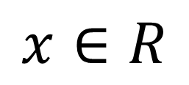
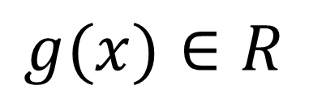
Functions and Graphs
An important bit of notation to remember…
x can be any ‘real number’
→ This is for the domain
g(x)
x
g(x) can be any ‘real number’
→ This is for the range
Real Number: A number which has a place on a normal number line. Includes positives, negatives, roots, pi etc…
→ Does not include imaginary numbers – eg √-1
2B

Slide 17
Functions and Graphs
Real Number: A number which has a place on a normal number line. Includes positives, negatives, roots, pi etc…
y
Domain changes
A mapping which is not a function, can be made into one by changing/restricting the domain (the starting values)
eg) y = +√x
If we restrict the domain to
x ≥ 0, then all values in the domain will map to one value in the range.
→ It now therefore meets the criteria for being a function!
x
This will not be a function as some values in the domain (x) will not give an answer in the range (y). For example, -2
The function
x is real numbers
x is greater than 0
2B

Slide 18
Functions and Graphs
Find the range of the following function, and state if it is one-to-one or many-to-one.
f(x) = 3x – 2, domain {x = 1, 2, 3, 4}
f(x) = 3x – 2, {x = 1, 2, 3, 4}
No inequality used as there are only certain values (discrete)
Domain
Range
1
1
Range of f(x):
{1, 4, 7, 10}
2
4
3
7
Description:
One to One
4
10
2B

Slide 19
Functions and Graphs
g(x) = x2
g(x)
Find the range of the following function, and state if it is one-to-one or many-to-one.
g(x) = x², domain {x є R, -5 ≤ x ≤ 5}
g(x) = x², {-5 ≤ x ≤ 5}
20
15
Range
10
5
x
Inequality, so you will have to sketch the graph
-4
-2
2
4
Range of g(x):
0 ≤ g(x) ≤ 25
Inequality used as the data is continuous
Description:
Many to one
2B

Slide 20
Functions and Graphs
h(x)
Find the range of the following function, and state if it is one-to-one or many-to-one.
h(x) = ¹/_{x}, domain {x є R, 0 < x ≤ 3}
h(x) = ¹/_{x}, {x є R, 0 < x ≤ 3}
8
6
Range
4
2
h(x) = 1/_{x}
x
Inequality, so you will have to sketch the graph
-3
-2
-1
1
2
3
Range of h(x):
h(x) ≥ 1/₃
In this domain, the smallest value is 1/₃
Description:
One to One
As we get close to 0, values will get infinitely high
2B

Slide 21
Functions and Graphs
f(x) = 5 – 2x
f(x)
f(x) = x2 + 3
You will need to be able to plot more than one function on the same set of axes, possibly for different domains.
The function f(x) is defined by:
a) Sketch f(x) stating its range
f(x) > 3
b) Find the values of a such that f(a) = 19
8
6
4
{
5 – 2x x < 1
2
f(x) =
x
x2 + 3 x ≥ 1
-3
-2
-1
1
2
3
→ Sketch both graphs on the same axes
→ Make sure you use the correct domain for each
The lowest value plotted is 3.
Careful though as for 5 – 2x, x cannot include 1. Therefore f(x) > 3 (not including 3)
2B

Slide 22
Functions and Graphs
f(x) = 5 – 2x
f(x)
f(x) = x2 + 3
You will need to be able to plot more than one function on the same set of axes, possibly for different domains.
The function f(x) is defined by:
a) Sketch f(x) stating its range
f(x) > 3
b) Find the values of a such that f(a) = 19
→ Solve both equations separately!
→ Remember that the answers must be within the domain given, or they cannot be included
8
6
4
{
5 – 2x x < 1
2
f(x) =
x2 + 3 x ≥ 1
x
-3
-2
-1
1
2
3
Linear Equation
Quadratic Equation
5 – 2x = 19
x2 + 3 = 19
– 2x = 14
x2 = 16
(Has to be greater than 1)
x = -7
x = ±4
x = 4
2B

Slide 23
Teachings for
Section 2C

Slide 24
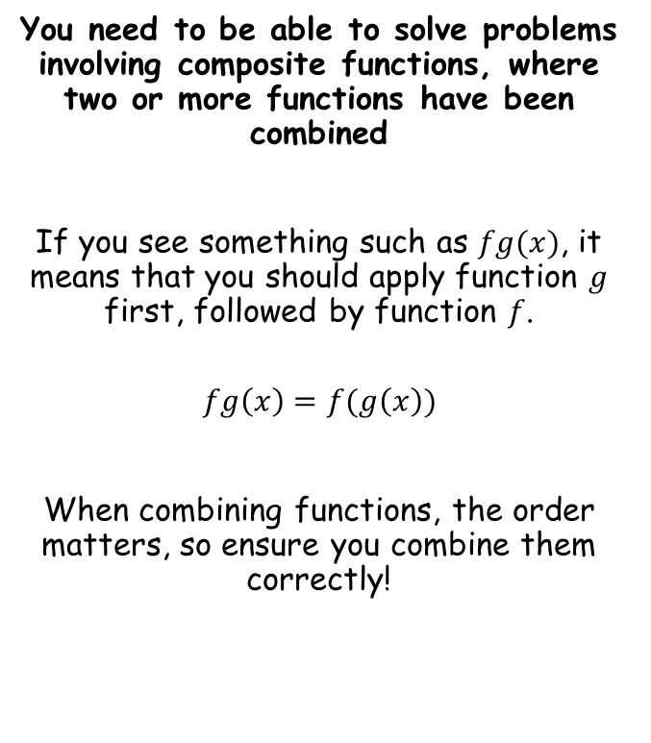
Functions and Graphs
You need to be able to solve problems involving composite functions, where two or more functions have been combined
If you see something such as $fg(x)$, it means that you should apply function $g$ first, followed by function $f$.
$$fg\left(x\right)=f(g\left(x\right))$$
When combining functions, the order matters, so ensure you combine them correctly!
2C

Slide 25
Functions and Graphs
You need to be able to solve problems involving composite functions, where two or more functions have been combined
Given:
f(x) = x²
g(x) = x + 1
Find:
a) fg(x)
b) gf(x)
It helps to write what you would do to x for each function
f(x) = x2
g(x) = x + 1
‘Square x’
‘Add 1 to x’
a) fg(x) means g acts first, followed by f.
fg(x)
Replace g(x) with the function
f(x + 1)
f(x) means ‘square x’, so square g(x)
(x + 1)2
Multiply out and simplify
fg(x) = x2 + 2x + 1
2C

Slide 26
Functions and Graphs
You need to be able to solve problems involving composite functions, where two or more functions have been combined
Given:
f(x) = x²
g(x) = x + 1
Find:
a) fg(x) = x² + 2x + 1
b) gf(x)
It helps to write what you would do to x for each function
f(x) = x2
g(x) = x + 1
‘Square x’
‘Add 1 to x’
b) gf(x) means f acts first, followed by g.
gf(x)
Replace f(x) with the function
g(x2)
g(x) means ‘add one to x’, so add 1 to f(x)
(x2) + 1
Simplify
gf(x) = x2 + 1
2C

Slide 27
Functions and Graphs
You need to be able to solve problems involving composite functions, where two or more functions have been combined
Given:
f(x) = 3x + 2
g(x) = x² + 4
Find:
a) fg(x)
b) gf(x)
c) f²(x)
d) The values of b so that fg(b) = 62
It helps to write what you would do to x for each function
f(x) = 3x + 2
g(x) = x2 + 4
‘Multiply by 3, then add 2’
‘Square x then add 4’
a) fg(x) means g acts first, followed by f.
fg(x)
Replace g(x) with the function
f(x2 + 4)
f(x) means ‘multiply by 3, then add 2’
3(x2 + 4) + 2
Multiply out and simplify
fg(x) = 3x2 + 12 + 2
fg(x) = 3x2 + 14
2C

Slide 28
Functions and Graphs
You need to be able to solve problems involving composite functions, where two or more functions have been combined
Given:
f(x) = 3x + 2
g(x) = x² + 4
Find:
a) fg(x) = 3x² + 14
b) gf(x)
c) f²(x)
d) The values of b so that fg(b) = 62
It helps to write what you would do to x for each function
f(x) = 3x + 2
g(x) = x2 + 4
‘Multiply by 3, then add 2’
‘Square x then add 4’
b) gf(x) means f acts first, followed by g.
gf(x)
Replace f(x) with the function
g(3x + 2)
g(x) means ‘square then add 4’
(3x + 2)2 + 4
Multiply out and simplify
gf(x) = 9x2 + 12x + 4 + 4
gf(x) = 9x2 + 12x + 8
2C

Slide 29
Functions and Graphs
You need to be able to solve problems involving composite functions, where two or more functions have been combined
Given:
f(x) = 3x + 2
g(x) = x² + 4
Find:
a) fg(x) = 3x² + 14
b) gf(x) = 9x² + 12x + 8
c) f²(x)
d) The values of b so that fg(b) = 62
It helps to write what you would do to x for each function
f(x) = 3x + 2
g(x) = x2 + 4
‘Multiply by 3, then add 2’
‘Square x then add 4’
c) f2(x) means f acts again on itself
f2(x)
Replace f(x) with the function
f(3x + 2)
f(x) means ‘multiply by 3, then add 2’
3(3x + 2) + 2
Multiply out and simplify
f2(x) = 9x + 6 + 2
f2(x) = 9x + 8
2C

Slide 30
Functions and Graphs
You need to be able to solve problems involving composite functions, where two or more functions have been combined
Given:
f(x) = 3x + 2
g(x) = x² + 4
Find:
a) fg(x) = 3x² + 14
b) gf(x) = 9x² + 12x + 8
c) f²(x) = 9x + 8
d) The values of b so that fg(b) = 62
It helps to write what you would do to x for each function
f(x) = 3x + 2
g(x) = x2 + 4
‘Multiply by 3, then add 2’
‘Square x then add 4’
d) fg(b) = 62, find b
fg(b) = 62
Replace fg(b) with the function fg(x)
3x2 + 14 = 62
Work through and solve the equation
3x2 = 48
x2 = 16
Remember 2 possible values
x = ± 4
2C

Slide 31




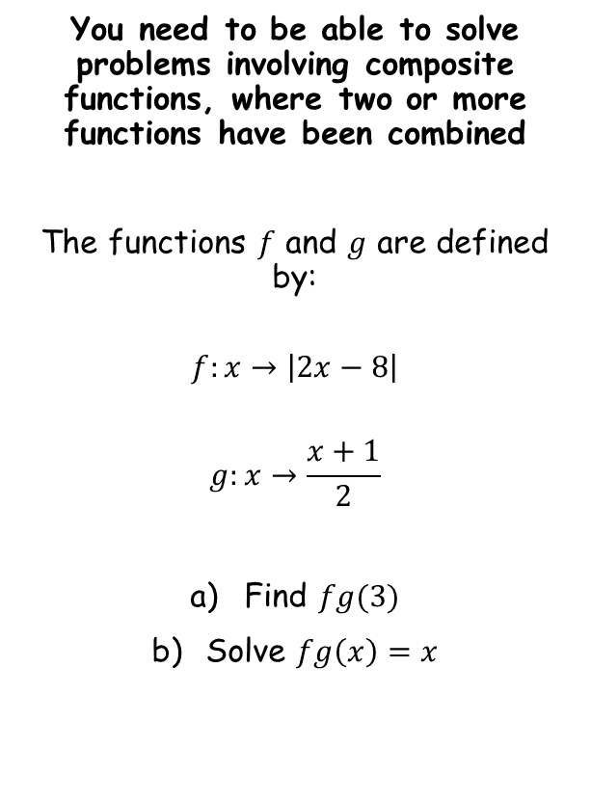






Functions and Graphs
You need to be able to solve problems involving composite functions, where two or more functions have been combined
The functions $f$ and $g$ are defined by:
$$f:x→\left|2x−8\right|$$
$$g:x→\frac{x+1}{2}$$
Find $fg(3)$
Solve $fg\left(x\right)=x$
$$g:x→\frac{x+1}{2}$$
Sub in $x=3$
$$g:3→\frac{3+1}{2}$$
Calculate
$$g:3→2$$
Now we substitute this value into $f:x$
$$f:x→\left|2x−8\right|$$
Sub in $x=2$
$$f:2→\left|2\left(2\right)−8\right|$$
Calculate
$$f:2→\left|−4\right|$$
Use the modulus
$$f:2→4$$
2C

Slide 32



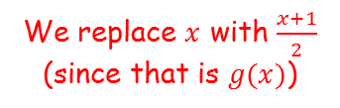





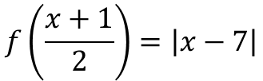


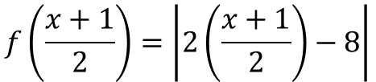


Functions and Graphs
$$f\left(x\right)=\left|2x−8\right|$$
You need to be able to solve problems involving composite functions, where two or more functions have been combined
The functions $f$ and $g$ are defined by:
$$f:x→\left|2x−8\right|$$
$$g:x→\frac{x+1}{2}$$
Find $fg(3)$
Solve $fg\left(x\right)=x$
We replace $x$ with $\frac{x+1}{2}$ (since that is $g(x)$)
$$f\left(\frac{x+1}{2}\right)=\left|2\left(\frac{x+1}{2}\right)−8\right|$$
Simplify right side
$$f\left(\frac{x+1}{2}\right)=\left|x−7\right|$$
So the equation we need to solve is:
$$\left|x−7\right|=x$$
$$y$$
$$y=x$$
$$−\left(x−7\right)=x$$
Expand bracket
$$y=−(x−7)$$
$$7$$
$$y=\left|x−7\right|$$
$$−x+7=x$$
Add $x$
$$x$$
$$7=2x$$
Divide by 2
$$7$$
$$3.5=x$$
2C

Slide 33
Teachings for
Section 2D

Slide 34
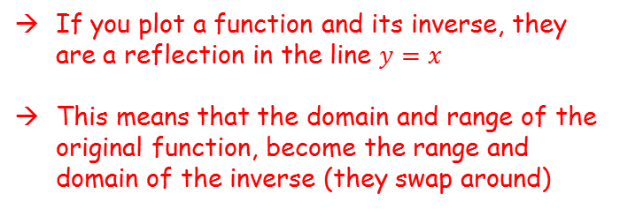

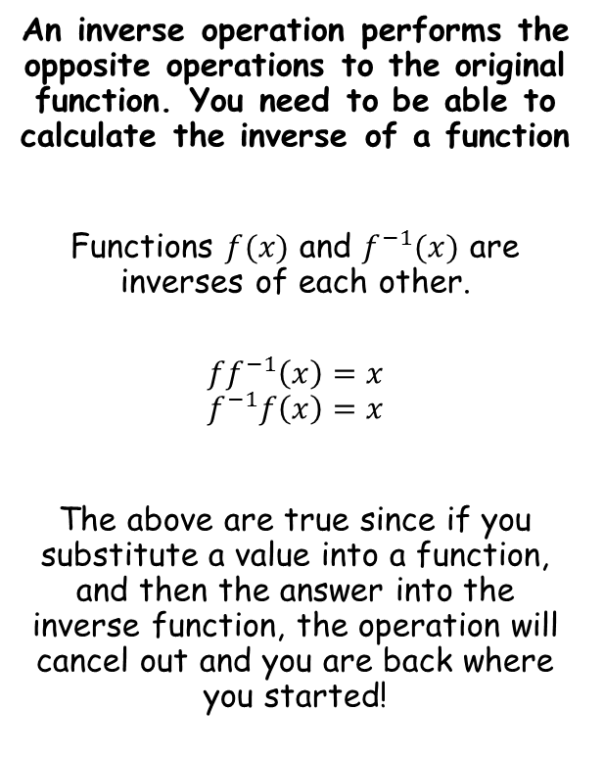


Functions and Graphs
$$y$$
$$f(x)$$
$$y=x$$
An inverse operation performs the opposite operations to the original function. You need to be able to calculate the inverse of a function
Functions $f(x)$ and $f^{−1}(x)$ are inverses of each other.
$$ff^{−1}\left(x\right)=x$$
$$f^{−1}f\left(x\right)=x$$
The above are true since if you substitute a value into a function, and then the answer into the inverse function, the operation will cancel out and you are back where you started!
$$f^{−1}(x)$$
$$x$$
If you plot a function and its inverse, they are a reflection in the line $y=x$
This means that the domain and range of the original function, become the range and domain of the inverse (they swap around)
2D

Slide 35

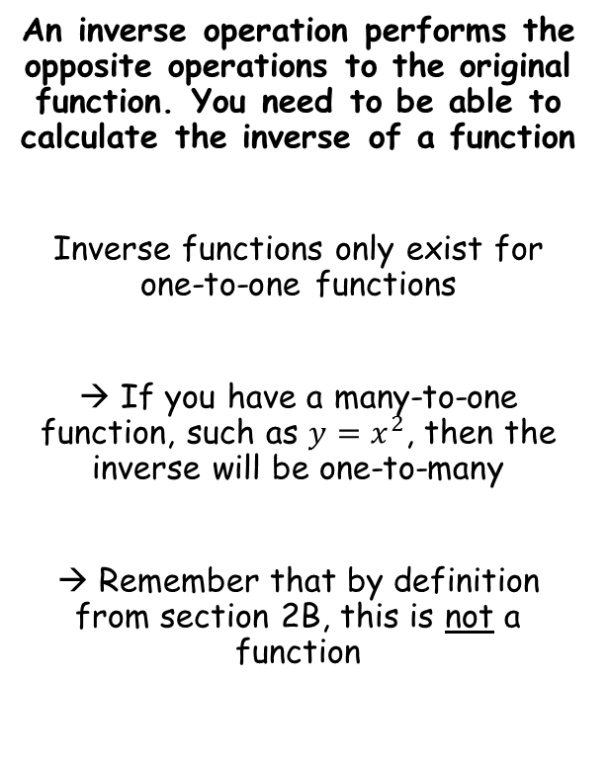


Functions and Graphs
An inverse operation performs the opposite operations to the original function. You need to be able to calculate the inverse of a function
Inverse functions only exist for one-to-one functions
→ If you have a many-to-one function, such as $y=x^{2}$, then the inverse will be one-to-many
→ Remember that by definition from section 2B, this is not a function
$$y=x^{2}$$
$$y$$
$$y=x$$
$$y=\sqrt{x}$$
$$x$$
2D

Slide 36


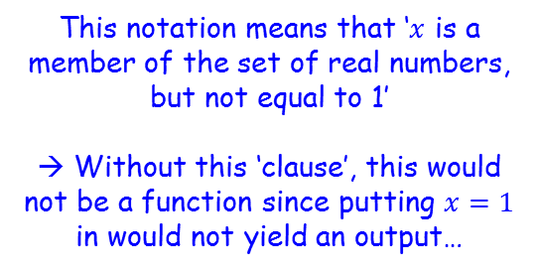


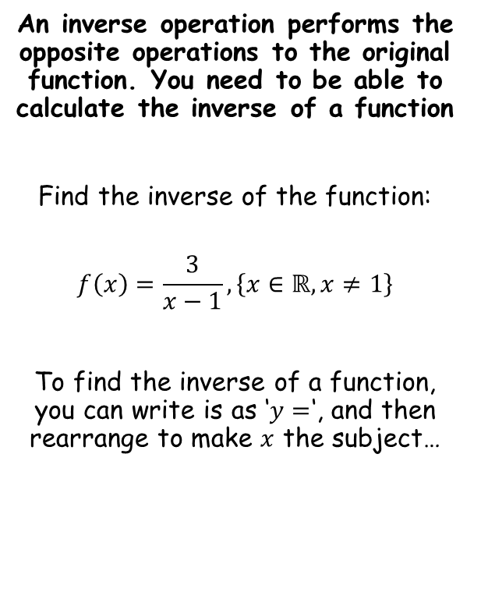






Functions and Graphs
An inverse operation performs the opposite operations to the original function. You need to be able to calculate the inverse of a function
Find the inverse of the function:
$$f\left(x\right)=\frac{3}{x−1}, \left\{x∈ℝ, x≠1\right\}$$
To find the inverse of a function, you can write is as ‘$y=$‘, and then rearrange to make $x$ the subject…
$$y=\frac{3}{x−1}$$
Multiply by $(x−1)$
$$y(x−1)=3$$
Expand bracket
$$xy−y=3$$
Add $y$
$$xy=3+y$$
Divide by $y$
$$x=\frac{3+y }{y}$$
Rewrite using $x$ and the inverse function notation
$$f^{−1}(x)=\frac{3+x }{x}$$
This notation means that ‘$x$ is a member of the set of real numbers, but not equal to 1’
→ Without this ‘clause’, this would not be a function since putting $x=1$ in would not yield an output…
2D

Slide 37
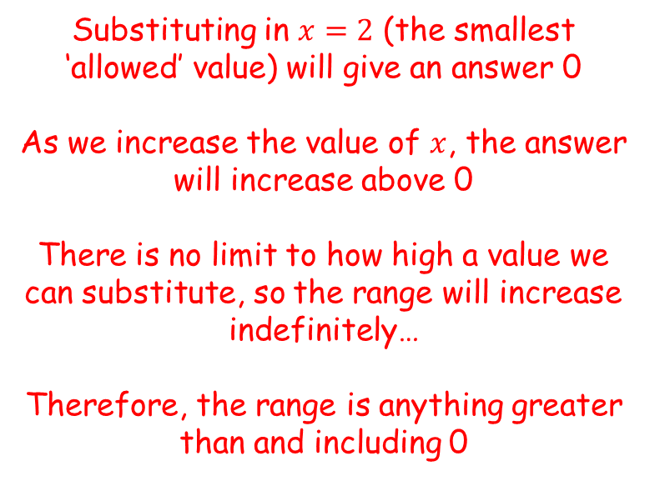
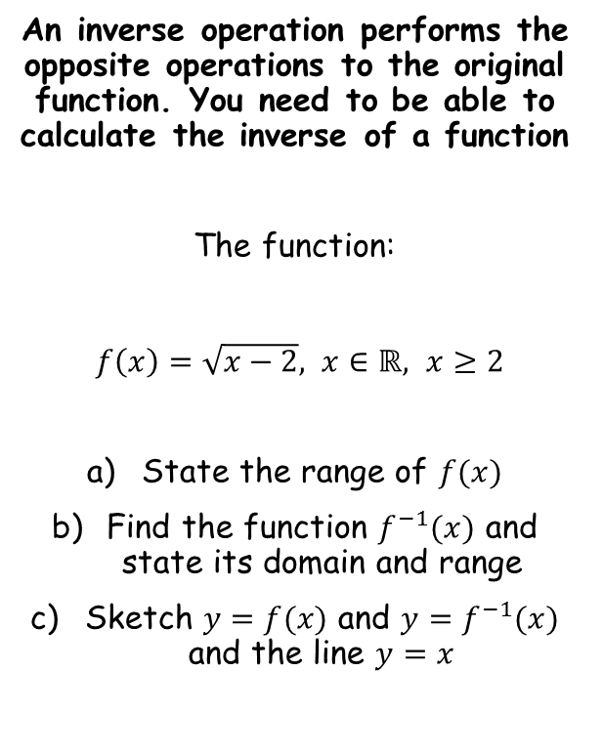

Functions and Graphs
An inverse operation performs the opposite operations to the original function. You need to be able to calculate the inverse of a function
The function:
$f\left(x\right)=\sqrt{x−2}, x∈ℝ, x≥2$
State the range of $f(x)$
Find the function $f^{−1}(x)$ and state its domain and range
Sketch $y=f(x)$ and $y=f^{−1}(x)$ and the line $y=x$
Substituting in $x=2$ (the smallest ‘allowed’ value) will give an answer 0
As we increase the value of $x$, the answer will increase above 0
There is no limit to how high a value we can substitute, so the range will increase indefinitely…
Therefore, the range is anything greater than and including 0
$$f\left(x\right)∈ℝ, f(x)≥0$$
You need to state your answer like the above, using the correct notation
2D

Slide 38

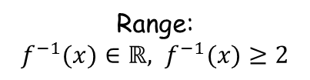




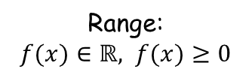




Functions and Graphs
An inverse operation performs the opposite operations to the original function. You need to be able to calculate the inverse of a function
The function:
$f\left(x\right)=\sqrt{x−2}, x∈ℝ, x≥2$
State the range of $f(x)$
Find the function $f^{−1}(x)$ and state its domain and range
Sketch $y=f(x)$ and $y=f^{−1}(x)$ and the line $y=x$
$$y=\sqrt{x−2}$$
Square both sides
$$y^{2}=x−2$$
Add 2
$$y^{2}+2=x$$
Rewrite using the inverse function notation
$$f^{−1}\left(x\right)=x^{2}+2$$
$$f\left(x\right)∈ℝ, f(x)≥0$$
Original function
Inverse function
$$f\left(x\right)=\sqrt{x−2}$$
$$f^{−1}\left(x\right)=x^{2}+2$$
Domain:
$x∈ℝ, x≥2$
Domain:
$x∈ℝ, x≥0$
Consider the domain and range for the original function, and swap them around for the inverse…
Range:
$f(x)∈ℝ, f(x)≥0$
Range:
$f^{−1}(x)∈ℝ, f^{−1}(x)≥2$
2D

Slide 39





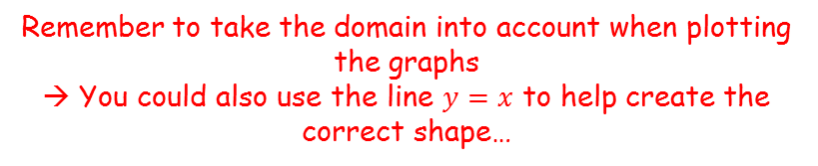
Functions and Graphs
An inverse operation performs the opposite operations to the original function. You need to be able to calculate the inverse of a function
The function:
$f\left(x\right)=\sqrt{x−2}, x∈ℝ, x≥2$
State the range of $f(x)$
Find the function $f^{−1}(x)$ and state its domain and range
Sketch $y=f(x)$ and $y=f^{−1}(x)$ and the line $y=x$
$$f\left(x\right)=\sqrt{x−2}$$
$x∈ℝ, x≥2$
$$f^{−1}\left(x\right)=x^{2}+2$$
$$x∈ℝ, x≥0$$
$$y=f^{−1}(x)$$
$$y$$
$$y=x$$
$$y=f(x)$$
2
$$f\left(x\right)∈ℝ, f(x)≥0$$
$$x$$
2
Remember to take the domain into account when plotting the graphs
→ You could also use the line $y=x$ to help create the correct shape…
2D

Slide 40

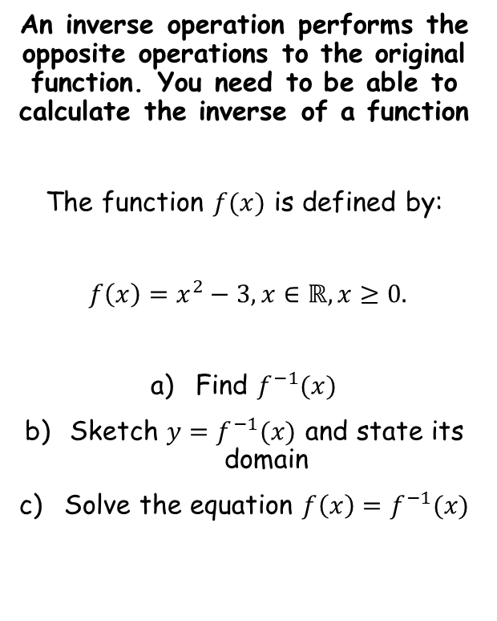



Functions and Graphs
An inverse operation performs the opposite operations to the original function. You need to be able to calculate the inverse of a function
The function $f(x)$ is defined by:
$f\left(x\right)=x^{2}−3, x∈ℝ, x≥0.$
Find $f^{−1}(x)$
Sketch $y=f^{−1}(x)$ and state its domain
Solve the equation $f\left(x\right)=f^{−1}(x)$
$$y=x^{2}−3$$
Add 3
$$y+3=x^{2}$$
Square root
$$\sqrt{y+3}=x$$
Rewrite using $x$ and the inverse function notation
$$f^{−1}(x)=\sqrt{x+3}$$
2D

Slide 41

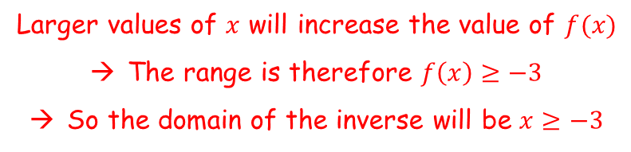


Functions and Graphs
An inverse operation performs the opposite operations to the original function. You need to be able to calculate the inverse of a function
The function $f(x)$ is defined by:
$f\left(x\right)=x^{2}−3, x∈ℝ, x≥0.$
Find $f^{−1}(x)$
Sketch $y=f^{−1}(x)$ and state its domain
Solve the equation $f\left(x\right)=f^{−1}(x)$
We need to know the domain to be able to draw the sketch
→ We can find the domain by finding the range of the original function
$$f\left(x\right)=x^{2}−3$$
Sub in 0
$$f\left(0\right)=−3$$
Larger values of $x$ will increase the value of $f(x)$
The range is therefore $f\left(x\right)≥−3$
So the domain of the inverse will be $x≥−3$
$$f^{−1}(x)=\sqrt{x+3}$$
2D

Slide 42


Functions and Graphs
An inverse operation performs the opposite operations to the original function. You need to be able to calculate the inverse of a function
The function $f(x)$ is defined by:
$f\left(x\right)=x^{2}−3, x∈ℝ, x≥0.$
Find $f^{−1}(x)$
Sketch $y=f^{−1}(x)$ and state its domain
Solve the equation $f\left(x\right)=f^{−1}(x)$
$$f^{−1}\left(x\right)=\sqrt{x+3}, x≥−3$$
$$y$$
$$y=f^{−1}(x)$$
-3
$$x$$
$$f^{−1}(x)=\sqrt{x+3}$$
2D

Slide 43


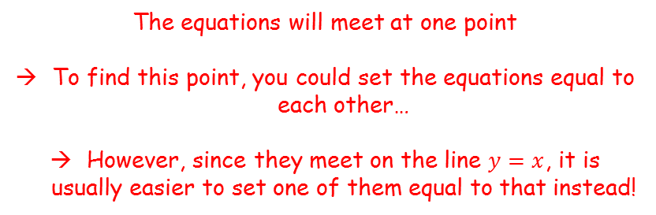
Functions and Graphs
An inverse operation performs the opposite operations to the original function. You need to be able to calculate the inverse of a function
The function $f(x)$ is defined by:
$f\left(x\right)=x^{2}−3, x∈ℝ, x≥0.$
Find $f^{−1}(x)$
Sketch $y=f^{−1}(x)$ and state its domain
Solve the equation $f\left(x\right)=f^{−1}(x)$
$$f^{−1}\left(x\right)=\sqrt{x+3}, x≥−3$$
$$y$$
$$y=f(x)$$
$$y=f^{−1}(x)$$
-3
$$x$$
-3
$$y=x$$
The equations will meet at one point
To find this point, you could set the equations equal to each other…
However, since they meet on the line $y=x$, it is usually easier to set one of them equal to that instead!
$$f^{−1}(x)=\sqrt{x+3}$$
2D

Slide 44




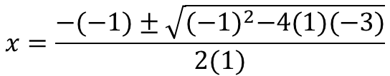




Functions and Graphs
An inverse operation performs the opposite operations to the original function. You need to be able to calculate the inverse of a function
The function $f(x)$ is defined by:
$f\left(x\right)=x^{2}−3, x∈ℝ, x≥0.$
Find $f^{−1}(x)$
Sketch $y=f^{−1}(x)$ and state its domain
Solve the equation $f\left(x\right)=f^{−1}(x)$
$$x^{2}−3=x$$
Subtract $x$
$$x^{2}−x−3=0$$
$$a=1$$
$$b=−1$$
$$c=−3$$
$$x=\frac{−b±\sqrt{b^{2}−4ac}}{2a}$$
Sub in values
$$x=\frac{−(−1)±\sqrt{{(−1)}^{2}−4(1)(−3)}}{2(1)}$$
Calculate (in this case the answer must be positive, based on the graph we sketched)
$$x=\frac{1+\sqrt{13}}{2}$$
$$f^{−1}(x)=\sqrt{x+3}$$
2D

Slide 45
Teachings for
Section 2E

Slide 46



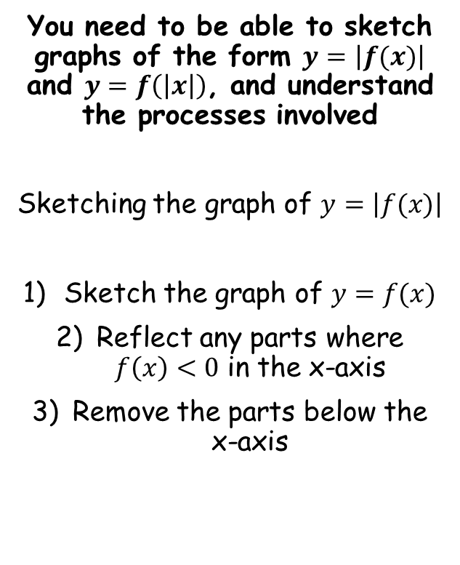




Functions and Graphs
You need to be able to sketch graphs of the form $y=\left|f(x)\right|$ and $y=f\left(\left|x\right|\right)$, and understand the processes involved
Sketching the graph of $y=\left|f(x)\right|$
Sketch the graph of $y=f(x)$
Reflect any parts where $f\left(x\right)<0$ in the x-axis
Remove the parts below the x-axis
$$f\left(x\right)=x^{2}−3x−10$$
Sketch $y=f(x)$ and $y=\left|f(x)\right|$
$$f(x)=x^{2}−3x−10$$
$$f(x)=(x−5)(x+2)$$
Crosses the x-axis at 5 and -2
The y-intercept is at -10
$$y$$
$$f(x)$$
$$y$$
$$\left|f(x) \right|$$
$$f(x)$$
10
-2
5
$$x$$
-2
5
$$x$$
The modulus above is of the whole function
→ This means that any final answers (‘y’) that we get which are negative, they will become positive at the end
-10
-10
2E

Slide 47

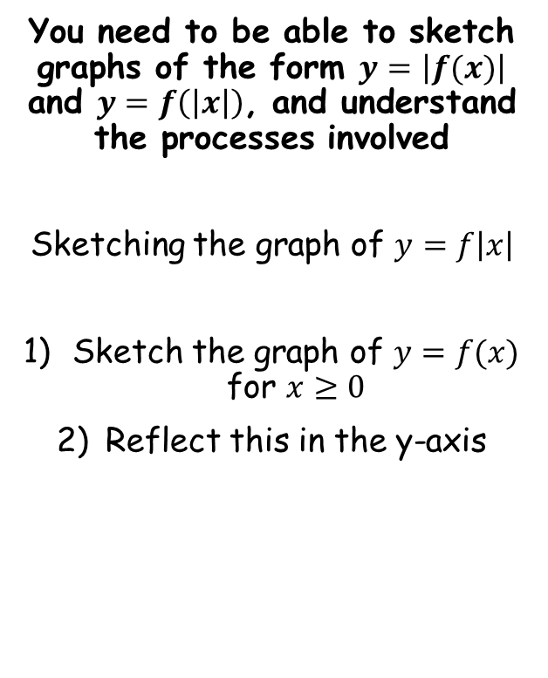


Functions and Graphs
You need to be able to sketch graphs of the form $y=\left|f(x)\right|$ and $y=f\left(\left|x\right|\right)$, and understand the processes involved
Sketching the graph of $y=f\left|x\right|$
Sketch the graph of $y=f(x)$ for $x≥0$
Reflect this in the y-axis
$$f\left(x\right)=x^{2}−3x−10$$
Sketch $y=f(x)$ and $y=f\left(\left|x\right|\right)$
$$f(x)=x^{2}−3x−10$$
$$f(x)=(x−5)(x+2)$$
Crosses the x-axis at 5 and -2
The y-intercept is at -10
$$y$$
$$f(x)$$
$$y$$
$$f\left(\left|x\right|\right)$$
$$f(x)$$
The modulus above is of the inputs (x)
→ This means that when we put in a negative number, we get the same output as for the equivalent positive number
-2
5
$$x$$
-5
5
$$x$$
-10
-10
2E

Slide 48

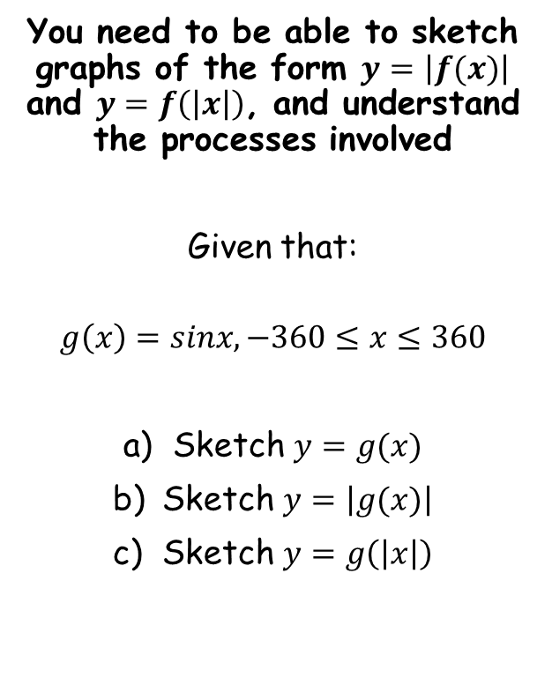




Functions and Graphs
$$y$$
You need to be able to sketch graphs of the form $y=\left|f(x)\right|$ and $y=f\left(\left|x\right|\right)$, and understand the processes involved
Given that:
$$g\left(x\right)=sinx, −360≤x≤360$$
Sketch $y=g(x)$
Sketch $y=\left|g(x)\right|$
Sketch $y=g\left(\left|x\right|\right)$
$$y=g(x)$$
1
$$x$$
-360
-180
180
360
-1
$$y$$
$$y=\left|g(x) \right|$$
$$y=g(x)$$
1
$$x$$
-360
-180
180
360
-1
$$y$$
1
$$y=g(\left|x\right|)$$
$$x$$
-360
-180
180
360
-1
2E

Slide 49









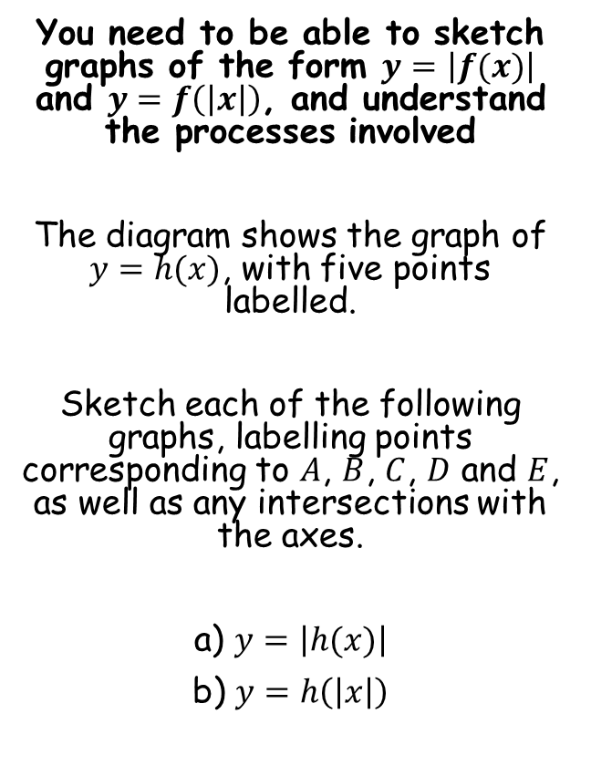
















Functions and Graphs
$$y$$
You need to be able to sketch graphs of the form $y=\left|f(x)\right|$ and $y=f\left(\left|x\right|\right)$, and understand the processes involved
The diagram shows the graph of $y=h(x)$, with five points labelled.
Sketch each of the following graphs, labelling points corresponding to $A$, $B$, $C$, $D$ and $E$, as well as any intersections with the axes.
a) $y=\left|h(x)\right|$
b) $y=h\left(\left|x\right|\right)$
$$(−2.5,15)$$
$$B$$
$$C$$
$$11$$
$$A$$
$$−7$$
$$D$$
$$x$$
$$3$$
$$y=h(x)$$
$$E$$
$$(6,−5)$$
$$y$$
$$(−2.5,15)$$
$$B$$
$$C$$
$$11$$
$$E′$$
$$(6,5)$$
$$y=\left|h(x) \right|$$
$$A$$
$$−7$$
$$D$$
$$x$$
$$3$$
$$y=h(x)$$
$$E$$
$$(6,−5)$$
2E

Slide 50






Functions and Graphs
$$y$$
You need to be able to sketch graphs of the form $y=\left|f(x)\right|$ and $y=f\left(\left|x\right|\right)$, and understand the processes involved
The diagram shows the graph of $y=h(x)$, with five points labelled.
Sketch each of the following graphs, labelling points corresponding to $A$, $B$, $C$, $D$ and $E$, as well as any intersections with the axes.
a) $y=\left|h(x)\right|$
b) $y=h\left(\left|x\right|\right)$
$$(−2.5,15)$$
$$B$$
$$C$$
$$11$$
$$A$$
$$−7$$
$$D$$
$$x$$
$$3$$
$$y=h(x)$$
$$E$$
$$(6,−5)$$
$$y$$
$$C$$
$$11$$
$$D′$$
$$−3$$
$$D$$
$$x$$
$$3$$
$$y=h(x)$$
$$y=h(\left|x\right|)$$
$$E′$$
$$E$$
$$(−6,−5)$$
$$(6,−5)$$
2E

Slide 51
Teachings for
Section 2F

Slide 52


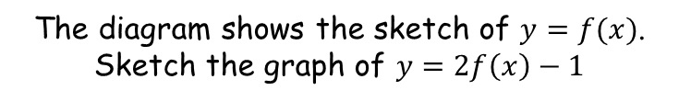


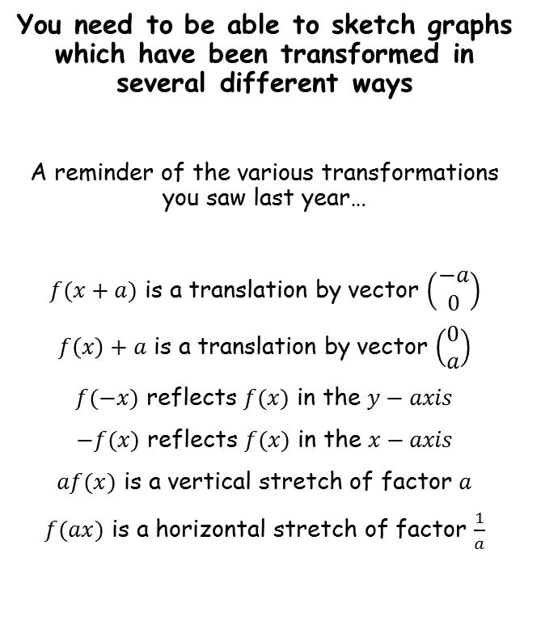






Functions and Graphs
The diagram shows the sketch of $y=f(x)$. Sketch the graph of $y=2f\left(x\right)−1$
You need to be able to sketch graphs which have been transformed in several different ways
A reminder of the various transformations you saw last year…
$f(x+a)$ is a translation by vector $\left(\begin{matrix}−a \\ 0\end{matrix}\right)$
$f\left(x\right)+a$ is a translation by vector $\left(\begin{matrix}0 \\ a\end{matrix}\right)$
$f(−x)$ reflects $f(x)$ in the $y−axis$
$−f(x)$ reflects $f(x)$ in the $x−axis$
$af(x)$ is a vertical stretch of factor $a$
$f(ax)$ is a horizontal stretch of factor $\frac{1}{a}$
$$B′$$
$$(6,7)$$
$$y=f(x)$$
$$y$$
$$(6,4)$$
$$B$$
$$A$$
$$x$$
$$(2,−1)$$
$$(2,−3)$$
$$2f\left(x\right)−1$$
→ Vertical stretch factor 2, then vertical translation 1 unit down
$$A′$$
$$y=2f\left(x\right)−1$$
→ The y-coordinates double, then decrease by 1
2F

Slide 53

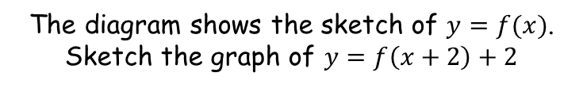






Functions and Graphs
The diagram shows the sketch of $y=f(x)$. Sketch the graph of $y=f\left(x+2\right)+2$
You need to be able to sketch graphs which have been transformed in several different ways
A reminder of the various transformations you saw last year…
$f(x+a)$ is a translation by vector $\left(\begin{matrix}−a \\ 0\end{matrix}\right)$
$f\left(x\right)+a$ is a translation by vector $\left(\begin{matrix}0 \\ a\end{matrix}\right)$
$f(−x)$ reflects $f(x)$ in the $y−axis$
$−f(x)$ reflects $f(x)$ in the $x−axis$
$af(x)$ is a vertical stretch of factor $a$
$f(ax)$ is a horizontal stretch of factor $\frac{1}{a}$
$$y=f\left(x+2\right)+2$$
$$y$$
$$B′$$
$$(4,6)$$
$$B$$
$$(6,4)$$
$$A′$$
$$(0,1)$$
$$A$$
$$x$$
$$(2,−1)$$
$$y=f(x)$$
$$f\left(x+2\right)+2$$
→ Horizontal translation 2 units to the left, then vertical translation 2 units up
You should apply the bracketed parts first!
→ The x-coordinates decrease by 2, and the y-coordinates increase by 2
2F

Slide 54

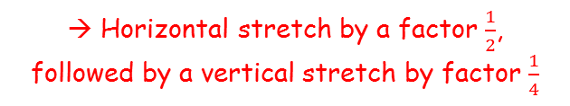

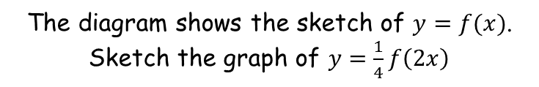



Functions and Graphs
The diagram shows the sketch of $y=f(x)$. Sketch the graph of $y=\frac{1}{4}f\left(2x\right)$
You need to be able to sketch graphs which have been transformed in several different ways
A reminder of the various transformations you saw last year…
$$y$$
$$B$$
$$\frac{1}{4}f\left(2x\right)$$
$$(6,4)$$
$$y=\frac{1}{4}f\left(2x\right)$$
→ Horizontal stretch by a factor $\frac{1}{2}$, followed by a vertical stretch by factor $\frac{1}{4}$
$$\left(1,−\frac{1}{4}\right)$$
$$B′$$
$$(3,1)$$
$$A′$$
$$A$$
$$x$$
→ The x-coordinates get divided by 2, and the y-coordinates get divided by 4
$$(2,−1)$$
$$y=f(x)$$
2F

Slide 55


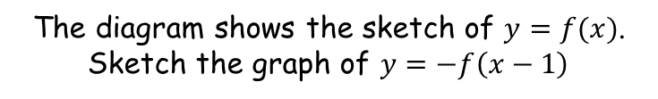



Functions and Graphs
The diagram shows the sketch of $y=f(x)$. Sketch the graph of $y=−f\left(x−1\right)$
You need to be able to sketch graphs which have been transformed in several different ways
A reminder of the various transformations you saw last year…
$$y$$
$$B$$
$$−f\left(x−1\right)$$
$$(6,4)$$
$$\left(3,1\right)$$
$$A′$$
→ Horizontal translation 1 unit to the right, followed by a reflection in the x-axis
$$A$$
$$x$$
→ The x-coordinates get increased by 1, and then the y-coordinates get multiplied by -1
$$(2,−1)$$
$$y=f(x)$$
$$(7,−4)$$
$$B′$$
$$y=−f\left(x−1\right)$$
2F

Slide 56

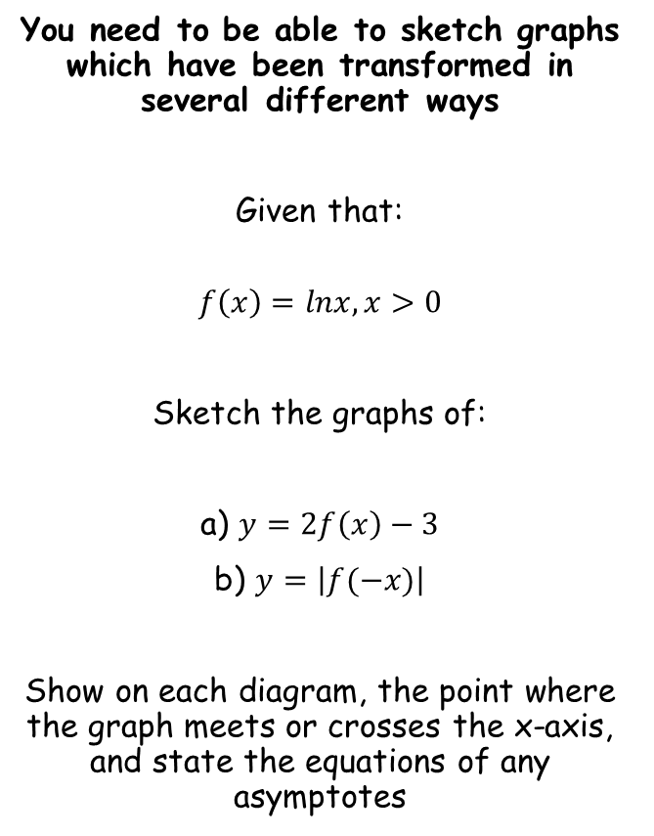




Functions and Graphs
$$y$$
$$y=lnx$$
You need to be able to sketch graphs which have been transformed in several different ways
Given that:
$$f\left(x\right)=lnx, x>0$$
Sketch the graphs of:
a) $y=2f\left(x\right)−3$
b) $y=\left|f(−x)\right|$
Show on each diagram, the point where the graph meets or crosses the x-axis, and state the equations of any asymptotes
Asymptote at $x=0$
1
$$x$$
The graph will be stretched vertically by a factor of 2, and then translated down 3 units
→ A good way of sketching is to do each translation one step at a time (although it is fine to calculate the coordinates at the end)
$$y$$
$$y=2lnx$$
$$y$$
$$y=2lnx−3$$
$$x$$
$$x$$
Asymptote at $x=0$
Asymptote at $x=0$
2F

Slide 57








Functions and Graphs
$$y$$
You need to be able to sketch graphs which have been transformed in several different ways
Given that:
$$f\left(x\right)=lnx, x>0$$
Sketch the graphs of:
a) $y=2f\left(x\right)−3$
b) $y=\left|f(−x)\right|$
Show on each diagram, the point where the graph meets or crosses the x-axis, and state the equations of any asymptotes
$$y=2lnx−3$$
$$4.48$$
$$x$$
Asymptote at $x=0$
To find the x-intercept, set $y=0$
$$2lnx−3=0$$
Add 3
$$2lnx=3$$
Divide by 2
$$lnx=1.5$$
Inverse logarithm
$$x=e^{1.5}$$
Calculate, or use the exact value
$$x=4.48$$
2F

Slide 58


Functions and Graphs
$$y$$
$$y=lnx$$
You need to be able to sketch graphs which have been transformed in several different ways
Given that:
$$f\left(x\right)=lnx, x>0$$
Sketch the graphs of:
a) $y=2f\left(x\right)−3$
b) $y=\left|f(−x)\right|$
Show on each diagram, the point where the graph meets or crosses the x-axis, and state the equations of any asymptotes
Asymptote at $x=0$
1
$$x$$
For the second transformation:
Reflect the graph in the y-axis
Then any values below the x-axis will be reflected above it
$$y=ln⁡(−x)$$
$$y$$
$$y=\left|ln⁡(−x) \right|$$
$$y$$
-1
$$x$$
-1
$$x$$
Asymptote at $x=0$
Asymptote at $x=0$
2F

Slide 59
Teachings for
Section 2G

Slide 60


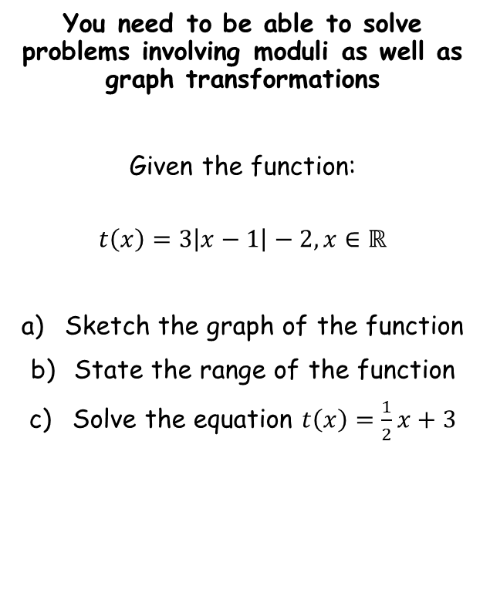




Functions and Graphs
$$y$$
$$y=\left|x\right|$$
$$y$$
$$y=\left|x−1\right|$$
You need to be able to solve problems involving moduli as well as graph transformations
Given the function:
$$t\left(x\right)=3\left|x−1\right|−2, x∈ℝ$$
Sketch the graph of the function
State the range of the function
Solve the equation $t\left(x\right)=\frac{1}{2}x+3$
1
$$x$$
1
$$x$$
Translation $\left(\begin{matrix}1 \\ 0\end{matrix}\right)$
$$y$$
$$y=3\left|x−1\right|$$
$$y$$
$$y=3\left|x−1\right|−2$$
3
1
1
$$x$$
$$x$$
Build up the sketch in stages…
(1,-2)
Vertical stretch factor 3
Translation $\left(\begin{matrix}0 \\ −2\end{matrix}\right)$
2G

Slide 61


Functions and Graphs
$$y$$
$$y=3\left|x−1\right|−2$$
You need to be able to solve problems involving moduli as well as graph transformations
Given the function:
$$t\left(x\right)=3\left|x−1\right|−2, x∈ℝ$$
Sketch the graph of the function
State the range of the function
Solve the equation $t\left(x\right)=\frac{1}{2}x+3$
Range
1
$$x$$
(1,-2)
So the range is any real values greater than or equal to -2
→ Use the correct notation when writing this!
$t\left(x\right)∈ℝ,$ $t\left(x\right)≥−2$
2G

Slide 62






Functions and Graphs
$$y$$
$$y=3\left|x−1\right|−2$$
You need to be able to solve problems involving moduli as well as graph transformations
Given the function:
$$t\left(x\right)=3\left|x−1\right|−2, x∈ℝ$$
Sketch the graph of the function
State the range of the function
Solve the equation $t\left(x\right)=\frac{1}{2}x+3$
$$y=\frac{1}{2}x+3$$
1
$$x$$
(1,-2)
Finding the first solution (on the non-reflected part of the graph)
$$\frac{1}{2}x+3=3\left(x−1\right)−2$$
Expand bracket and simplify
$$\frac{1}{2}x+3=3x−5$$
Add 5, subtract $\frac{1}{2}x$
$$8=2.5x$$
Divide by 2.5
$$3.2=x$$
2G

Slide 63






Functions and Graphs
$$y$$
$$y=3\left|x−1\right|−2$$
You need to be able to solve problems involving moduli as well as graph transformations
Given the function:
$$t\left(x\right)=3\left|x−1\right|−2, x∈ℝ$$
Sketch the graph of the function
State the range of the function
Solve the equation $t\left(x\right)=\frac{1}{2}x+3$
$$y=\frac{1}{2}x+3$$
1
$$x$$
(1,-2)
Finding the second solution (on the reflected part of the graph)
$$\frac{1}{2}x+3=−3\left(x−1\right)−2$$
Expand bracket and simplify
$$x=3.2$$
$$\frac{1}{2}x+3=−3x+1$$
Subtract 1, subtract $\frac{1}{2}x$
$$2=−3.5x$$
Divide by 2.5
$$−\frac{4}{7}=x$$
2G

Slide 64
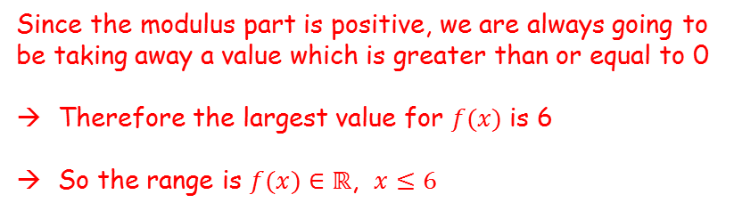

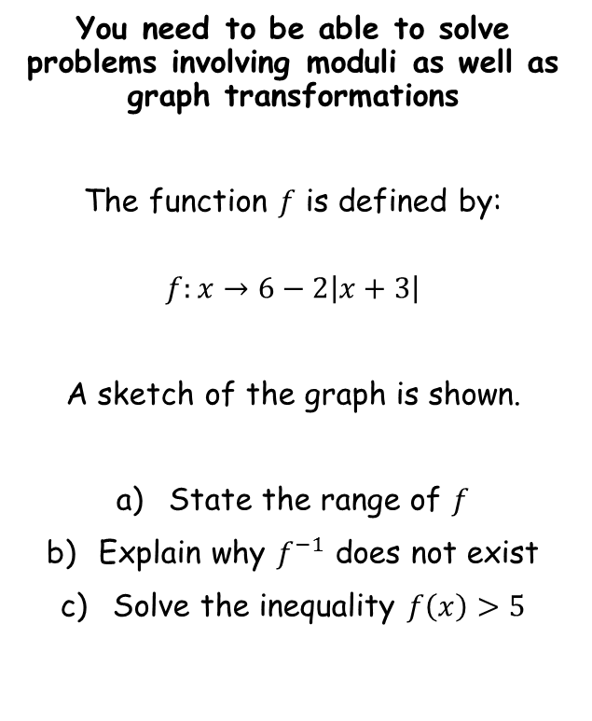


Functions and Graphs
$$y$$
You need to be able to solve problems involving moduli as well as graph transformations
The function $f$ is defined by:
$$f:x→6−2\left|x+3\right|$$
A sketch of the graph is shown.
State the range of $f$
Explain why $f^{−1}$ does not exist
Solve the inequality $f\left(x\right)>5$
$$f\left(x\right)=6−2\left|x+3\right|$$
$$6$$
Range
$$x$$
$$6$$
$$0$$
Since the modulus part is positive, we are always going to be taking away a value which is greater than or equal to 0
Therefore the largest value for $f(x)$ is 6
So the range is $f(x)∈ℝ$, $x≤6$
2G

Slide 65
Functions and Graphs
$$y$$
You need to be able to solve problems involving moduli as well as graph transformations
The function $f$ is defined by:
$$f:x→6−2\left|x+3\right|$$
A sketch of the graph is shown.
State the range of $f$
Explain why $f^{−1}$ does not exist
Solve the inequality $f\left(x\right)>5$
$$f\left(x\right)=6−2\left|x+3\right|$$
$$6$$
$$x$$
$$6$$
$$0$$
This function is many-to-one, as different inputs can give the same output
The inverse would be one-to-many, which is not a function
2G

Slide 66






Functions and Graphs
$$y$$
You need to be able to solve problems involving moduli as well as graph transformations
The function $f$ is defined by:
$$f:x→6−2\left|x+3\right|$$
A sketch of the graph is shown.
State the range of $f$
Explain why $f^{−1}$ does not exist
Solve the inequality $f\left(x\right)>5$
$$f\left(x\right)=6−2\left|x+3\right|$$
$$6$$
$$f\left(x\right)=5$$
$$x$$
$$6$$
$$−2.5$$
$$0$$
Solving for the non-reflected part
$$6−2\left(x+3\right)=5$$
Expand bracket
$$6−2x−6=5$$
Simplify
$$−2x=5$$
Divide by 2
$$x=−2.5$$
2G

Slide 67





Functions and Graphs
$$y$$
You need to be able to solve problems involving moduli as well as graph transformations
The function $f$ is defined by:
$$f:x→6−2\left|x+3\right|$$
A sketch of the graph is shown.
State the range of $f$
Explain why $f^{−1}$ does not exist
Solve the inequality $f\left(x\right)>5$
$$f\left(x\right)=6−2\left|x+3\right|$$
$$6$$
$$f\left(x\right)=5$$
$$x$$
$$6$$
$$−3.5$$
$$−2.5$$
$$0$$
Solving for the reflected part
$$6+2\left(x+3\right)=5$$
Expand bracket
$$6+2x+6=5$$
Rearrange
$$2x=−7$$
Divide by 2
$$x=−3.5$$
2G

Slide 68
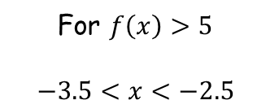
Functions and Graphs
$$y$$
You need to be able to solve problems involving moduli as well as graph transformations
The function $f$ is defined by:
$$f:x→6−2\left|x+3\right|$$
A sketch of the graph is shown.
State the range of $f$
Explain why $f^{−1}$ does not exist
Solve the inequality $f\left(x\right)>5$
$$f\left(x\right)=6−2\left|x+3\right|$$
$$6$$
$$f\left(x\right)=5$$
$$x$$
$$6$$
$$−3.5$$
$$−2.5$$
$$0$$
For $f\left(x\right)>5$
$$−3.5<x<−2.5$$
2G

